Slide 1

Machine Learning based Brain Tumor Detection and Classification using HOG Feature Descriptor
Author Details
Swati Shilaskar, Shripad Bhatlawande, Tejas Mahajan, Suraj Chaudhari, Rohan Mahajan, Khushi Junnare.
Department of Electronics and Telecommunication
Vishwakarma Institute of Technology
Pune, India

Slide 2
Introduction
Brain tumors are abnormal cell growths in the brain that can be treated based on the tumor stage.
Identification and categorization of brain tumors are crucial in modern medical research.
The Research does predictive analysis to identify and classify brain tumors.
Machine learning techniques are used to detect and classify brain tumors

Slide 3
Literature Survey
Papers | Dataset | Technique | Performance
Ankit Ghosh et. al | Binary Classified Dataset 2. Multiclass Classified Dataset | SVM, KNN, XGBoost, Random Forest, Gradient Boosting | Gradient Boosting Outperforms with accuracy of 92.40%.
Gokalp Cinarer et al | Rembrandt dataset by TCIA | KNN, LDA, SVM, Random Forest | SVM provided highest accuracy of 90%
Astina Minz et al. | Br35H | Feature Extraction is done using GLCM and Adaboost classifier | Accuracy Achieved by Adaboost is 89.90%
Md Khairul Islam et al | BRATS dataset | TK-means clustering algorithm used tumor segmentation | Proposed system provides accuracy of 95%.

Slide 4
Research Gap
Present Research Focused more on only Detecting Tumor
Lack of focus on specific types of brain tumors
Limited and Specific dataset

Slide 5
Novelty
Compilation of three dataset.
Ability to classify specific tumor
Computationally Inexpensive

Slide 6
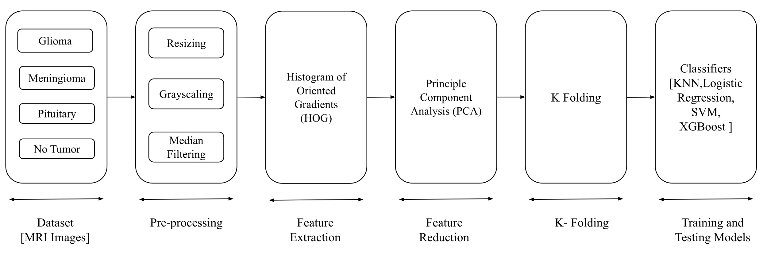
Proposed System

Slide 7
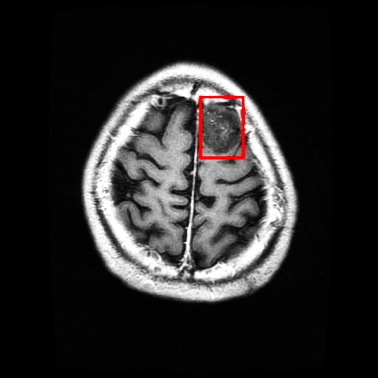
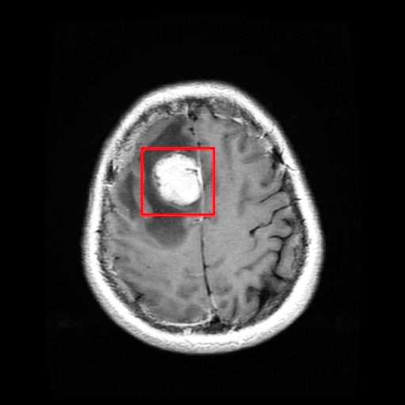
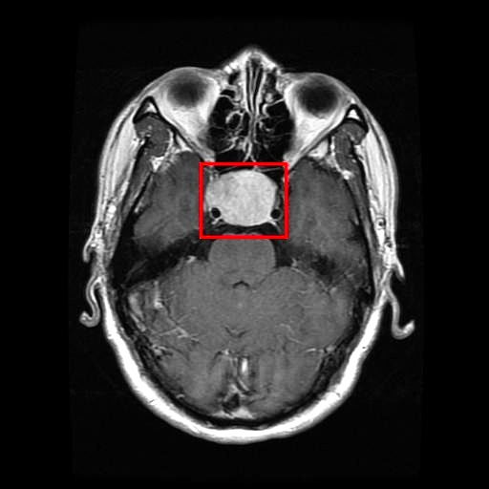
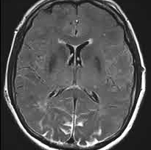
Dataset
Combination of Figshare, SARTAJ, and Br35H Dataset.
Contains four classes
Glioma
Meningioma
Pituitary
No Tumor
Fig. 1 Glioma Tumor
Fig. 2 Meningioma Tumor
Fig. 3 Pituitary Tumor
Fig. 4 No Tumor

Slide 8
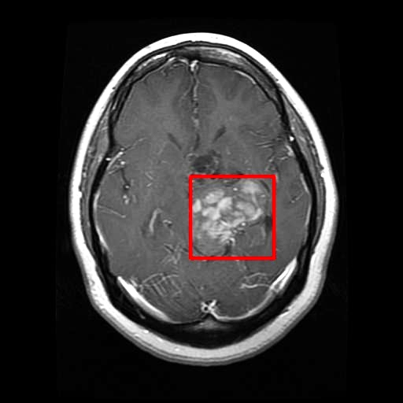
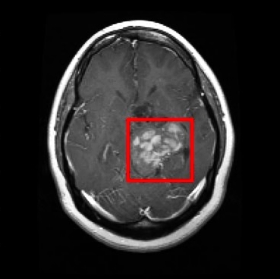
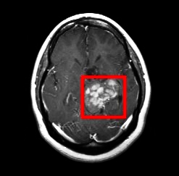
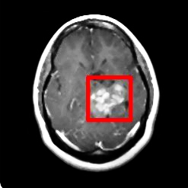
Pre-processing
Resizing
Gray scaling
Filtering
Fig. 5 Input Image
Fig. 6 Resized Image
Fig. 7 Grayscale Image
Fig. 8 Filtered Image

Slide 9
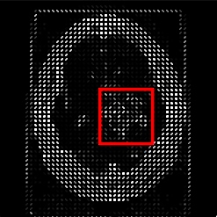
Feature Extraction
Histogram of Oriented Gradients (HOG)
Calculate Feature on Gradient Orientation and Magnitude

Slide 10
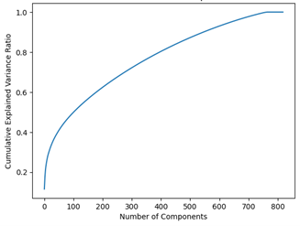
Feature Reduction
Principle Component Analysis (PCA)
Feature vector of 100 features.

Slide 11
Classifier Performance
Classifiers | Accuracy | Precision | Recall | F1 Score
Gradient Boost | 67.53 | 70.64 | 66.97 | 67.51
KNN | 68.52 | 95.15 | 68.19 | 77.85
SVM | 74.19 | 77.08 | 75.40 | 75.83
Logistic Regression | 77.62 | 94.99 | 76.40 | 84.24
XG Boost | 92.02 | 92.07 | 91.82 | 91.85

Slide 12
Advantages and Limitation
Advantages:
Accurately classify tumors with high precision.
Simple & Lightweight system
Cost effective
Limitations:
Classify only Axial view images

Slide 13
Conclusion
Proposed system identifies and categorizes brain tumors using ML on MRI data.
System uses five classifiers, with XG Boost showing highest accuracy at 92.02%.
System's performance limited by MRI dataset but has potential for high precision in tumor detection.
ML techniques in healthcare could improve tumor detection and lead to better patient outcomes, but further research on larger datasets is necessary.

Slide 14
References
[1] https://www.kaggle.com/datasets/masoudnickparvar/brain-tumor-mridataset
[2] Ghosh, A., & Kole, A. L. O. K. (2021). A Comparative Study of Enhanced ML Algorithms for Brain Tumor Detection and Classification
[3] Minz, A., & Mahobiya, C. (2017, January). MR image classification using adaboost for brain tumor type. In 2017 IEEE 7th International Advance Computing Conference (IACC) (pp. 701-705). IEEE.
[4] Islam, M. K., Ali, M. S., Miah, M. S., Rahman, M. M., Alam, M. S., & Hossain, M. A. (2021). Brain tumor detection in MR image using superpixels, principal component analysis and template-based K-means clustering algorithm. ML with Applications, 5, 100044
[5] Sharma, M., Sharma, P., Mittal, R., & Gupta, K. (2021). Brain tumour detection using ML. Journal of Electronics, 3(4), 298-308

Slide 15
Thank You

